Slide 1
Broadcast Technology UG1
##:
Lighting and its Control
Jerry Foss
jeremy.foss@bcu.ac.uk

Slide 2
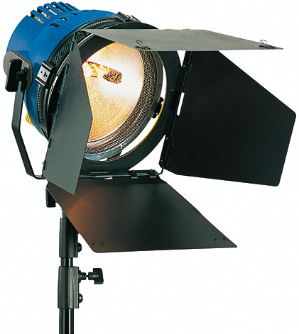
Luminaires
Lantern, Instrument
Housing
metal or plastic
prevents light spilling in unwanted directions
to reduce heat, increase efficiency
originally sheet steel or aluminium
increasingly die cast metal
allows single, light-weight body
economical to produce and use
some made from plastic
Lens Opening
lens often used to control the beam
reflector

Slide 3
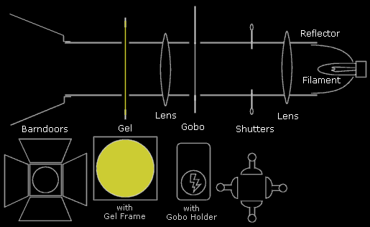

Luminaires
(not all of these features may be present in any given lamp)
Reflector
directs light in a specific direction
typically circular or oval to form a beam of light
Lens
typically - curved (plano-convex) lens
tend to be thick and heavy
option - Fresnel lens
Gobo
placed inside some lights to shape the light into patterns
patterns, logos, text, shapes
Gel (or colour filter)
colour correction
create mood
coloured sheet of plastic fixed to the front inside a gel frame
Shutters
series of metal plates to shape the beam
fully retracted - beam is circular
pushed in - beam can be square or rectangular
Barndoors
flaps - like shutters but not as precise, generally used to stop spilled light
http://people.bath.ac.uk/su2bc/infoguides/smc/basiclighting/index.shtml

Slide 4
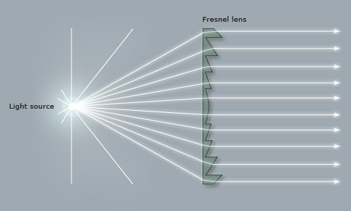
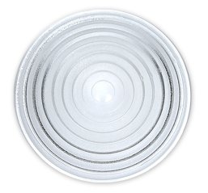
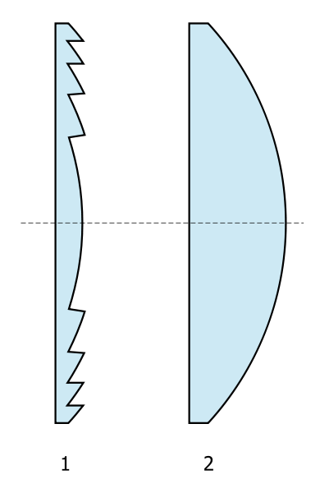
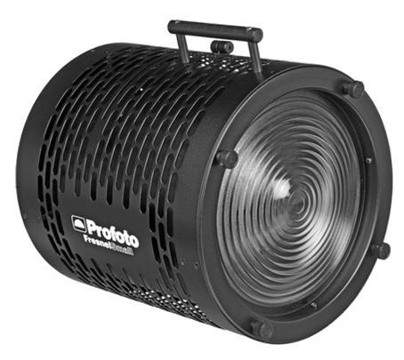
Fresnel Lens
(1) (2)
Fresnel Lens (1)
focuses light by using a series of separate sections
Conventional lens (2)
single, large lens, similar magnification power
significantly thicker, more expensive, harder to build

Slide 5
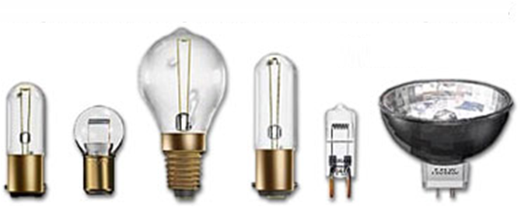
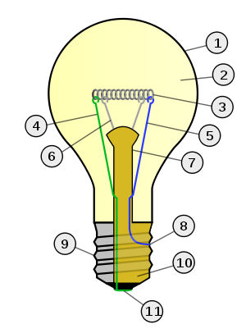
Incandescent (Tungsten) Lamp
Outline of Glass bulb
Low pressure inert gas (argon, neon, nitrogen)
Tungsten filament
Contact wire (goes out of stem)
Contact wire (goes into stem)
Support wires
Stem (glass mount)
Contact wire (goes out of stem)
Cap (sleeve)
Insulation (vitrite)
Electrical contact

Slide 6
Incandescent (Tungsten) Lamp
Incandescence
heated tungsten filament
black body radiation
enclosed in a glass bulb
vacuum or an inert gas to prevent oxidation of the filament
wide range of sizes and voltages
require no external regulating equipment
low manufacturing cost
AC or DC
widely used - household and commercial
being phased out, usually for energy saving alternatives
Very Inefficient:
radiate mostly infrared radiation
Incandescent lamp ~90% power consumed is emitted as heat

Slide 7
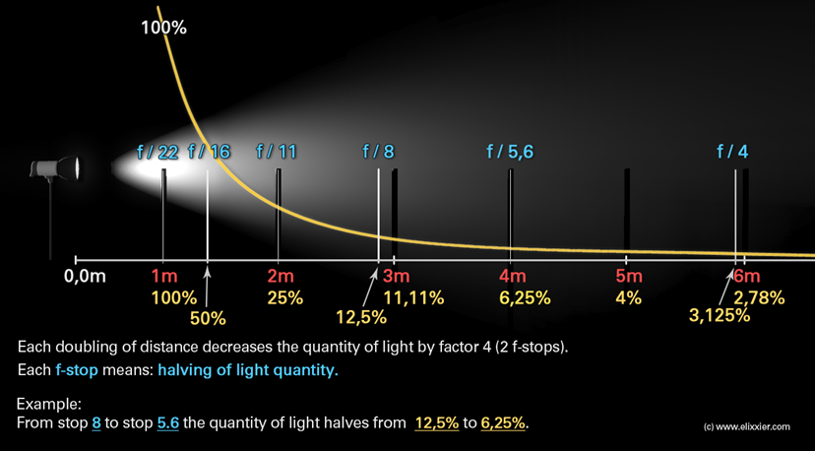
Propagation of Light (and Sound): Inverse Square Law
Between the 1st and second meter the brightness (intensity) has already decreased by 75% to only 25%
= 2 f-stops

Slide 8
Inverse Square Law
surface of sphere, radius=3r
e.g. the reduction of light, sound intensity further from the source
surface of sphere, radius=2r
A
A
A
surface of sphere, radius=r
A
A
A
A
A
A
r
A
A
A
A
Intensity = I
2r
A
A
r
3r
intensity is spread over a progressively bigger area
Sphere radius = r
Intensity (Energy):
at r = I
at 2r =
at 3r =
Sphere surface area =
Source Power = P
∴ intensity at surface of sphere
= I = Power =
Area
at nr =

Slide 9
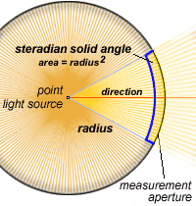
Lumens, Luminous Efficacy
Luminous Flux
visible light energy emitted, the power of light perceived by the human eye
i.e. the varying sensitivity of the human eye to different wavelengths of light
Radiant flux
total power of light emitted, Watts
Luminous Intensity
quantity of luminous flux emitted in a given direction per solid angle
Visible light energy emitted
(Luminous Flux)
in Lumens
Total power input to the lamp
in Watts
Luminous efficacy – a ratio ...
Efficacy = “Effectiveness”
:
… a measure of how well the distribution of energy matches the perception of the eye

Slide 10
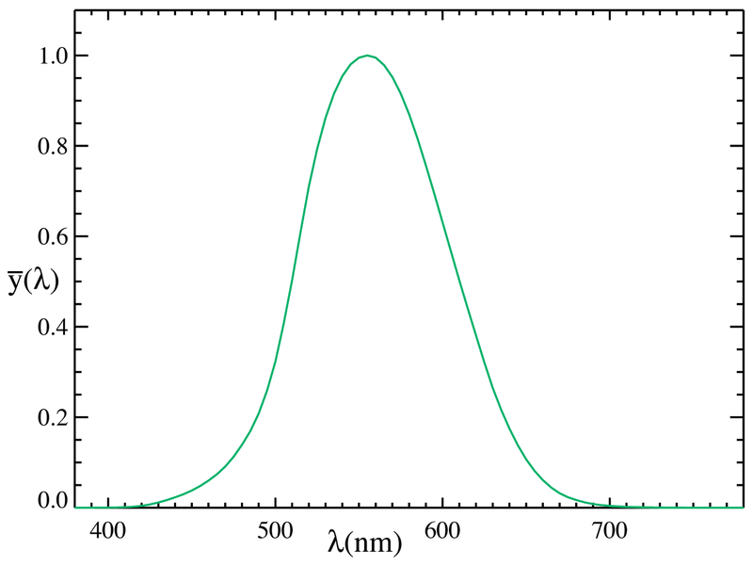
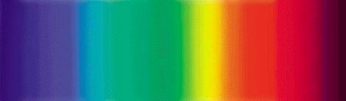
Lumens, Luminous Efficacy
Maximum efficacy possible
is 683 lm/W
for monochromatic green light at 555 nanometres wavelength
... the peak sensitivity of the human eye
For “white light”
maximum luminous efficacy is ~240 lm/W
... the human eye perceives many different mixtures of visible light as "white"
efficacy

Slide 11
Lumens, Luminous Efficacy
Type | Overall luminous efficiency | Overall luminous efficacy (lm/W)
40 W tungsten incandescent | 1.9% | 12.6
60 W tungsten incandescent | 2.1% | 14.5
100 W tungsten incandescent | 2.6% | 17.5
glass halogen | 2.3% | 16
quartz halogen | 3.5% | 24
high-temperature incandescent | 5.1% | 35
ideal black-body radiator at 4000 K | 7.0% | 47.5
ideal black-body radiator at 7000 K | 14% | 95
ideal monochromatic 555 nm (green) source | 100% | 683

Slide 12
Incandescent (Tungsten) Lamp
Outline of Glass bulb
Low pressure inert gas (argon, neon, nitrogen)
Tungsten filament
Contact wire (goes out of stem)
Contact wire (goes into stem)
Support wires
Stem (glass mount)
Contact wire (goes out of stem)
Cap (sleeve)
Insulation (vitrite)
Electrical contact

Slide 13
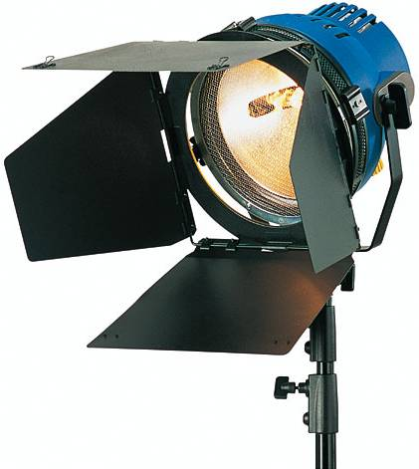
Tungsten / Halogen Lamps (aka Quartz Halogen)
tungsten filament “hot lights”
general use in film market up to 20kW
mobile – typ up to 2kW
for DV cameras ~1kW usually ok
Colour - Nominally 3000 - 3200K
Advantages
Cheap, uncomplicated
no need for an additional starter circuits
Disadvantages
Hot
Bulb life often short; often expensive bulbs
for daylight, a colour correction filter required
loses half the light output
Inefficient, Lumen-Per-Watt
least efficient technology on the market today

Slide 14
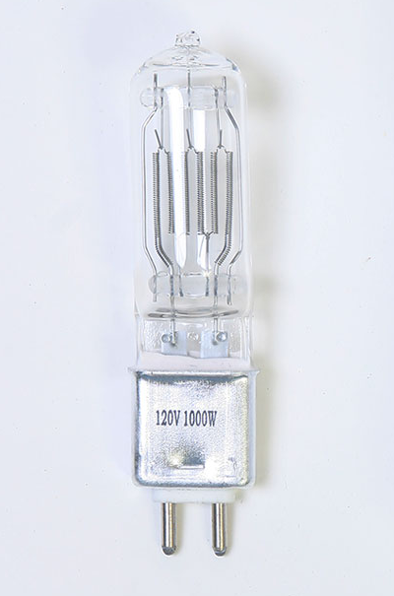
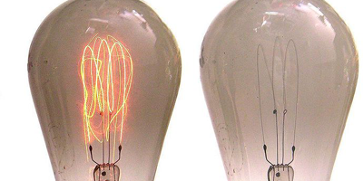
Halogen Lamps
operate at higher temperature than a standard gas filled lamp of similar power without loss of operating life
higher efficacy (10–30 lm/W)
Why Halogen …
Ordinary incandescent lamps
- tungsten is mostly deposited on the bulb
Halogen gas + Tungsten filament
>> chemical reaction - a halogen cycle
increases the lifetime of the bulb
prevents its darkening by redepositing tungsten from the inside of the bulb back onto the filament

Slide 15
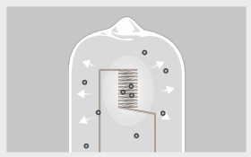
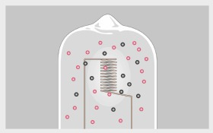
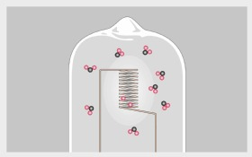
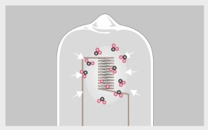
Halogen Cycle
Tungsten atoms evaporate from the hot filament
diffuse near cooler bulb wall
filament temperature ~ 3030º Celsius; bulb wall ~730º C
Tungsten, oxygen and halogen atoms combine near the glass
form tungsten oxyhalide molecules
Halogen used: originally iodine, now bromine
Tungsten oxyhalides remain in a vapor phase at the bulb-wall
vapor moves toward the hot filament
diffusion and convection currents are responsible for the movement
High temperatures near filament break the tungsten oxyhalide molecules apart oxygen and halogen atoms move back toward the bulb wall
tungsten atoms re-deposit on the filament
cycle repeats

Slide 16
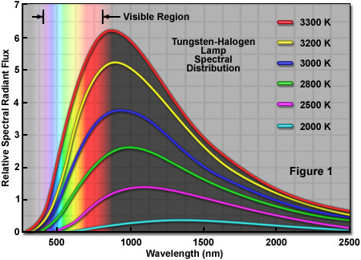
Halogen Lamps
produces a continuous* spectrum of light
from near ultraviolet to infrared
(c.f. arc lamps – “spikey” spectra)
filament operates at higher temperature than a non-halogen lamp
the spectrum is shifted toward blue
= higher effective colour temperature

Slide 17
Halogen Lamps
Warning!
hotter than regular incandescent lamps
heat is concentrated on a smaller envelope surface
surface is closer to the filament
sunburn risk from excess exposure to UV
... so usually have UV-absorbing glass filter

Slide 18
Halogen Lamps
Handling
contamination - notably fingerprints - can damage the quartz envelope when it is heated
contaminants create a hot spot on the bulb surface
extreme, localized heat causes the quartz to change from its vitreous form into a weaker, crystalline form that leaks gas
may form a bubble
leading to failure or explosion
∴ quartz lamps should be handled without touching the clear quartz

Slide 19
Power, Supply
Power requirements –
basic Ohm’s Law and Power equations
P = VI; Power (Watts) = Volts x Amps
V= IR; Volts = Amps x Ohms
Current protection, Fuses: use the next available current rating up;
although circuits in professional studios and sets will be protected by RCDs
RCDs - monitor for leakage current (in microamps) in the earth circuit
Standard voltage supply (UK) is 230V (+15% - 10%) ...
although studios will often have three phase power supply ...
note – for generators,
NET POWER quoted as kVA
POWER in the load is kW
... due to Power Factor

Slide 20
Mains Supply
AC Power supply in UK (and the rest of Europe) is 230V AC
AC = “alternating current”
… alternating at a rate of 50 Hz (cycles per second)
North America = 120V @ 60Hz
Varies quite a bit around the world
Peak = ~340V
RMS = 230V
0V
t
f-= 50Hz
Problem: What is the “average” value of the sinusoidal waveform?
Answer: Zero … but obviously this is misleading
Mathematically this is expressed as RMS … Root Mean Square
Practically, could consider the RMS voltage as the voltage required to produce the equivalent power (e.g. heating effect ) as a DC voltage

Slide 21
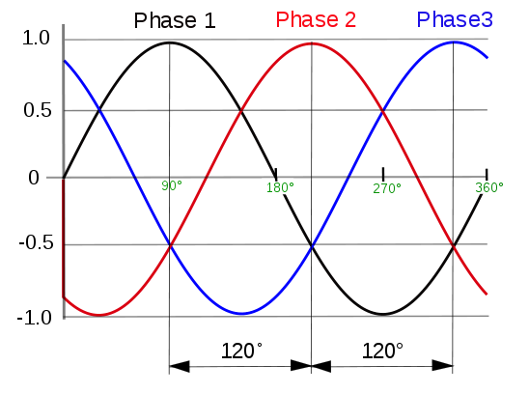
Three Phase Supply
0V
t
f-= 50Hz

Slide 22
Power, Supply
Power requirements –
basic Ohm’s Law and Power equations
P = VI; Power (Watts) = Volts x Amps
V= IR; Volts = Amps x Ohms
Current protection, Fuses: use the next available current rating up;
although circuits in professional studios and sets will be protected by RCDs
RCDs - monitor for leakage current (in microamps) in the earth circuit
Standard voltage supply (UK) is 230V (+15% - 10%) ...
although studios will often have three phase power supply ...
note – for generators,
NET POWER quoted as kVA
POWER in the load is kW
... due to Power Factor

Slide 23
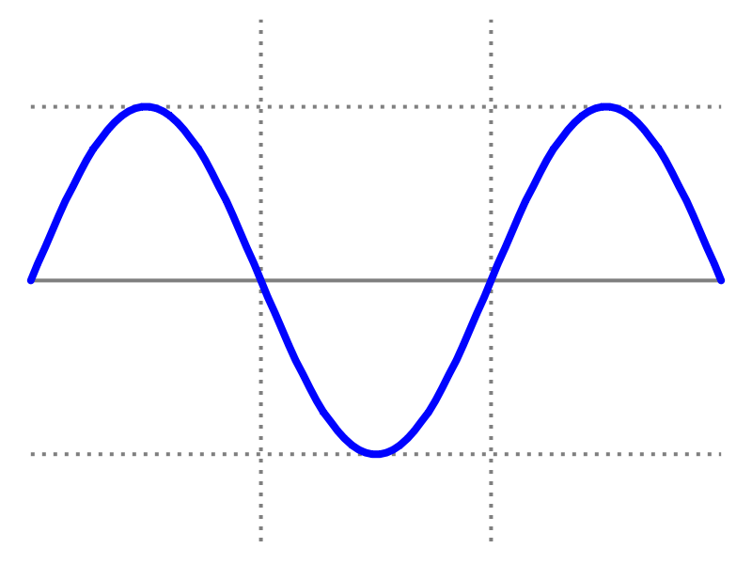
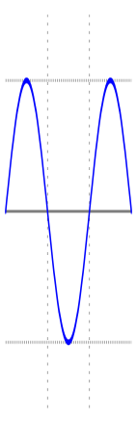
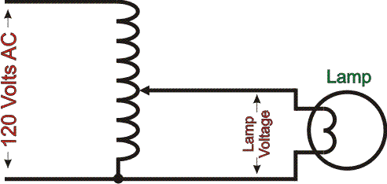
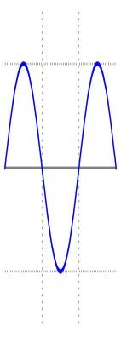
Variac
lost power
supply voltage, ac
(From 1934 to 2002, Variac was a U.S. trademark of General Radio)

Slide 24

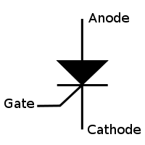
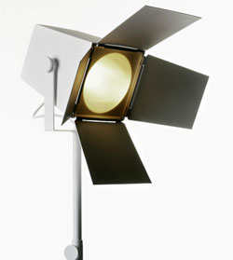
Solid State Control Devices
Typically: Thyristors - Silicon Controlled Rectifiers - SCRs
An SCR applied a “controlled rectification” of the wave form
the device can be set to turn on at specific points of the wave form
thus a modified supply wave is allowed through to the device
i.e. the load receives less than full power
Gate signal controls the current flowing through the device
Consider AC supply for a lamp:, full power
all of the power is contained in the AC wave form as it passes through each 360º cycle

Slide 25
Solid State Control Devices
Full waveform
Controlled waveform
Cutting the wave off earlier = more power, brighter light
Cutting the wave off later = less power, dimmer light
i.e. phase control

Slide 26
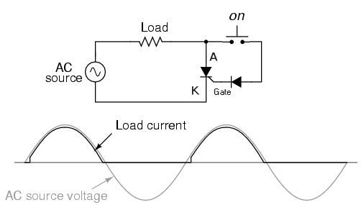
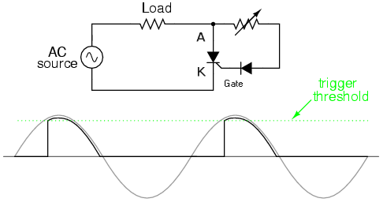
Solid State Control Devices
SCR applied – for one half of the waveform
Circuit for applying power to an AC load (e.g. a lamp)
By building the potentiometer into the circuit, control gate into the SCR allows the cut-off point to be set

Slide 27
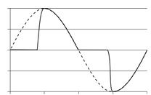
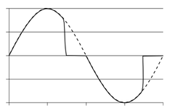
Forward / Reverse Phase Dimming

Slide 28
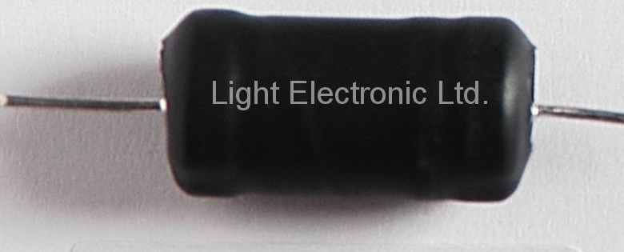
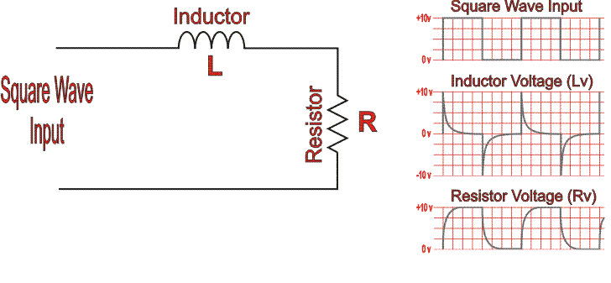
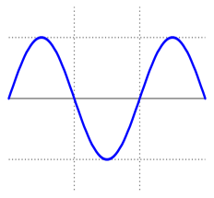
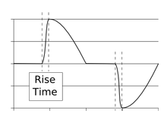
Buzzing Problems with Dimmers
Dimmer - normally has a filter choke
chokes filter out electrical noise
Choke
(choke)
Square wave has “hard edges” consisting of harmonics
The choke (inductor) takes all this immediate rise, leaving a softer rise of voltage to the resistor
For the waveform supplied by a SCR, the rapid switch time also requires a choke filter

Slide 29
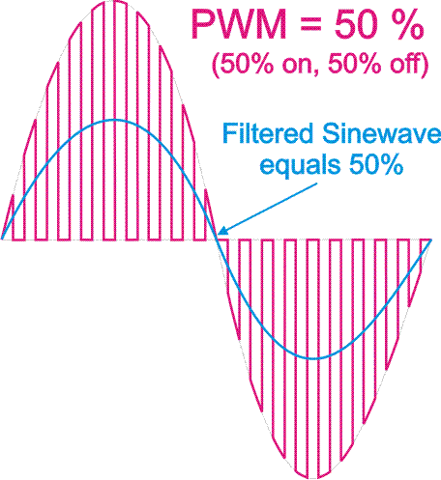
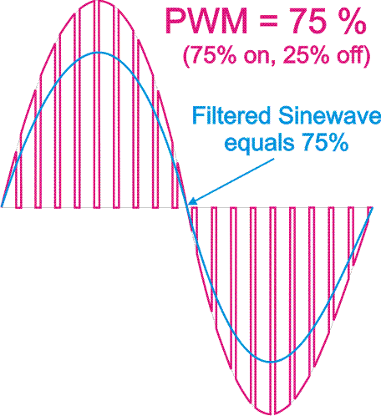
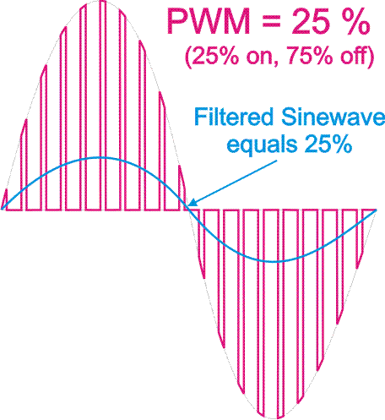
Sine Wave Dimming
The input supply sine wave is split into varying widths
Pulse Width Modulation (PWM)
Relative widths relates to the required reduction in output
The pulses are then filtered to produce the reduced amplitude output

Slide 30
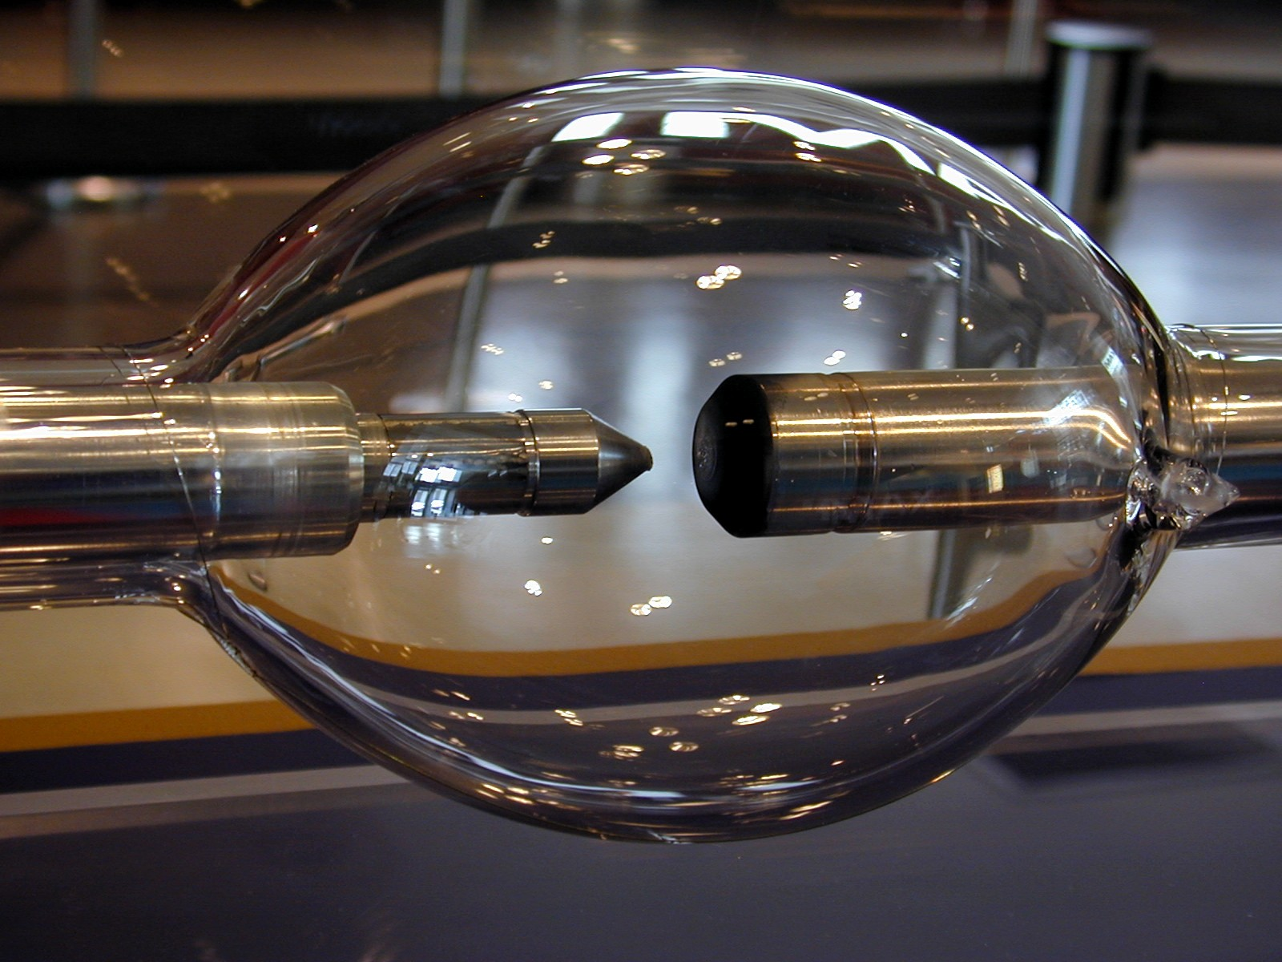
Arc, Discharge Lamps
High-Intensity Discharge lamps (HID lamps)
now common where a very bright light output is required - e.g. large follow spots
Hydrargyrum Medium-arc Iodide - HMI
floods, modern automated fixtures
cannot be electrically dimmed - use mechanical dousers or shutters

Slide 31
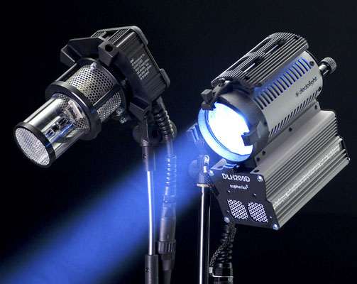
Arc, Discharge Lamps
electric arc in lamp of gas
gas ionized by a high voltage
therefore becomes electrically conductive
To start
small voltage lamps – no problem – relatively small voltage to strike the arc
Larger lamps:
very high voltage is pulsed across the lamp to "ignite" or "strike" the arc across the gas
requires an electrical circuit with an igniter and a ballast
ballast - is wired in series with the lamp

Slide 32
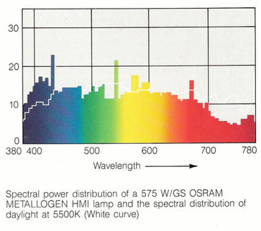
Colour Temperature
HMI - Hydrargyrum Medium-Arc Iodide
Incandescent lamp - peak irradiation lies much farther in the non-visible infrared area of the spectrum
compare to the wavelength of the maximal irradiation of the HMI
relative efficiency of HMI in producing visible light, whereas incandescent bulbs produce a much greater portion of non-usable heat.
Incandescent lamp
Relative Iridecence
http://galaxylightingrepair.com/images/hmi_info.jpg

Slide 33
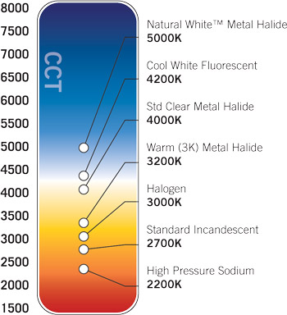
Correlated Colour Temperature
Tungsten light source – black-body-like
Some light sources not derived from a black body like source
HMI
Carbon Arc
Fluorescent
Xenon
HMI 5500-6500
Carbon Arc
fluorescent and HMIs - non-radiating
cannot have true colour temperature
contain spikes of slight hues
... commonly green or magenta
corrected using colour compensation lens filtration or lighting gels
for a spike - must use Colour Compensation filtration
equivalent colour value comparable to the Kelvin scale
Flash Bulbs 3400K

Slide 34
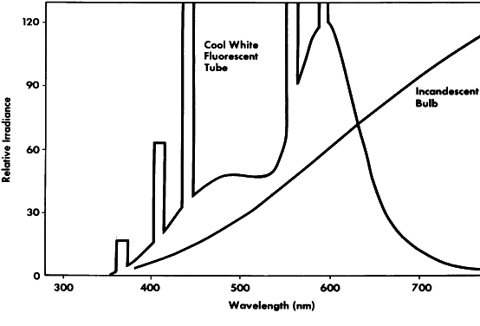
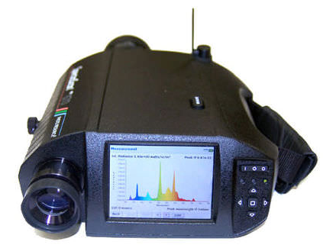
Colour Temperature - Correlated Colour Temperature
Colour Temperature for 'spiky' source
need to match arc source to incandescent source
then take the colour temperature of the incandescent source
However - to match colours for the convenience of the human eye ...
... not convenient - so meters used
meters designed to match the response of the eye
but difficult to predict response of the human eye or TV camera
spectroradiometers
made by - Thoma, Photo Research and Gamma Scientific
... analyze peaks and troughs
PR-670 SpectraScan

Slide 35
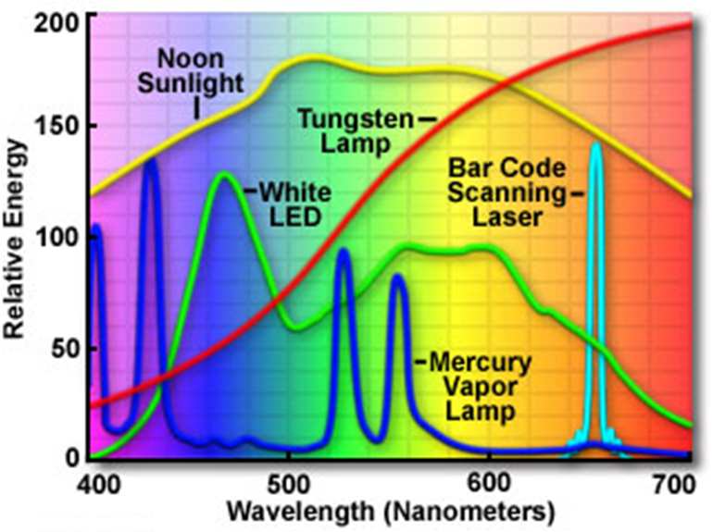
Spectra of Common Sources of Visible Light

Slide 36

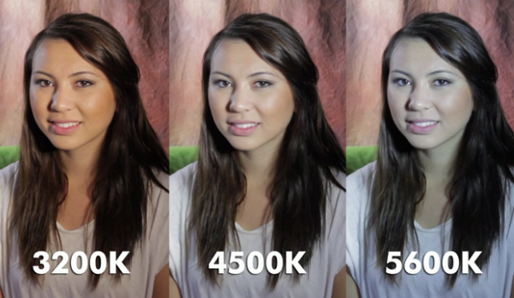
Mired
Micro Reciprocal Degree
to convey colour temperature
direct reciprocals of a corresponding degrees Kelvin colour temperature
simplifies working with colour temperatures
determine the strength of correction filter or gel
http://lacolouronline.com/blog/?10171-Defending-4500K-colour-Temperature

Slide 37
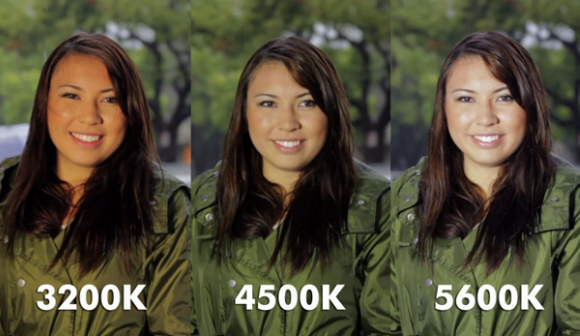
Mired Shift
Calculate required correction gel
'shift' a light source from (i) original colour temperature to (ii) a new one
Desired colour temperature – Original colour temperature
= mired difference
... so requires a colour correction filter equal to the mired difference
negative: increases colour temperature towards the blue end of the spectrum
positive: decreases the colour temperature towards the orange/red end of the spectrum
http://lacolouronline.com/blog/?10171-Defending-4500K-colour-Temperature

Slide 38
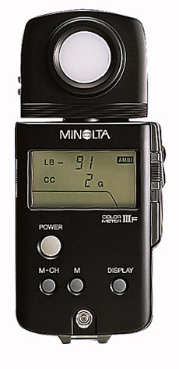
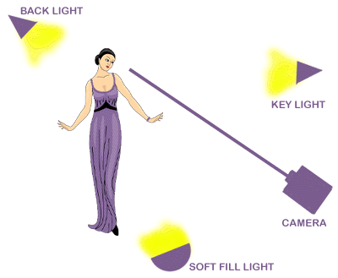
Mired Example
Key light is metered as 2900K
=
but colour temperature required is 3200K
=
312.5 – 344.8 = -32.3 Mireds
round down to -32
negative means increase colour temperature to blue end of spectrum
CT Blue filter

Slide 39
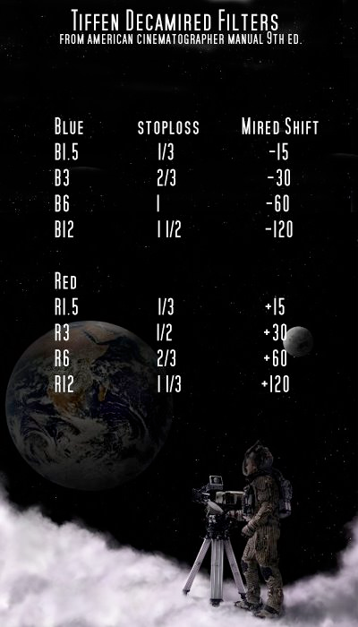

Mired Filters
http://www.ryanpatrickohara.com/download/colourtemperature.pdf

Slide 40

Mired Filters
http://www.leefilters.com/lighting/mired-shift-calculator.html

Slide 41



Colour Balance
Colour correction gels
CTB (colour temperature blue)
CTO (colour temperature orange)
CTB gel converts tungsten light of 3200K to 'daylight' colour
CTO gel performs the reverse
Beware different manufacturers' gels yield slightly different colours
definition of the colour of daylight - varies depending on the location (latitude, dust, pollution) and the time of day
Fluorescent lights
have a green cast – removed by a minus green gel
to add green cast - plus green
Strength of Gels
3/4, 1/2, 1/4, and 1/8
A 1/2 CTO gel is half the strength of a (full) CTO gel
¼ CTO
1/1 CTB
LCD with minus green

Slide 42
Colour Balance
Colour Name Effect
Cyan Absorbs Red
Yellow Absorbs Blue
Magenta Absorbs Green
Red Absorbs Blue and Green
Green Absorbs Red and Blue
Blue Absorbs Red and Green
(colour correction is more subtle than shown here)

Slide 43
Colour Balance
Filters stop light from passing through them, so the resultant light is reduced
colour correction gels only reduce small amounts of colour so are fairly “pale” filters
light reduction is minimal (but definitely there)
Tungsten Light Source Correction
CTB - convert Tungsten Light sources of 3200K to colour, comparable to daylight
make a key light appear to be from outdoor source such as the sky or a window
201 Full CTB : Tungsten to Daylight 3200K – 5700K
202 Half CTB : Tungsten to Daylight 3200K – 4300 K
203 Quarter CTB : Tungsten to Daylight 3200K – 3600K
219 Fluorescent Green: convert tungsten light to general fluorescent lighting
242 Fluorescent 4300K: convert tungsten light to fluorescent @ 4300K
http://www.onstagelighting.co.uk/lighting-design/colour-correction-filters-stage-lighting-gels/

Slide 44
Colour Balance
Daylight Light Source Correction
CTO - convert blue-ish light source of daylight to a range of tungsten colour temperatures
useful for balancing light sources from a window with tungsten key lighting
also used with a tungsten light to create a warm sunny keylight.
204 Full CTO: Daylight 6500 K to Tungsten 3200 K
205 Half CTO: Daylight 6500 K to Tungsten 3800 K
206 Quarter CTO: Daylight 6500 K to Tungsten 4600 K
Other filters for different light sources
HMI , CID and CSI arc lamps
some common correction filters for specific uses:
236 HMI to Tungsten 3200K: warm orange tint that can be used for sunlight in tungsten lights
237 CID to Tungsten 3200K: Light red/brown. Used with tungsten, produces a outdoor summer mood
238 CSI to Tungsten 3200K: similar to 237CID

Slide 45

LED Lighting
BBC Breakfast TV Studio, Media City, Salford
includes LED lighting

Slide 46

News Room, Broadcasting House, London

Slide 47


LEDs ... and producing white light
(1) RGB LEDs
combine red, green and blue LEDs
mix for wide range of colours, including white
RGB white light - generally poor
possible to shape the spectral emission
but dimensions bigger, less beam control
(... or 2 ...) Luminescence Conversion
convert the spectrum of a LED by using phosphors as a luminous layer
usually - blue LEDs with yellow phosphors coatings
better spectral distributions, good colour rendering
warm white, neutral white, daylight white
colour temp 2500K to 8000K
(RGB and White LED sprectra – see next slide)

Slide 48

LED Spectra
Typical colour filter spectra :
(left) RGB-LED spectrum has peaks for red, green and blue
(right) White-LED spectrum has dominant peak at 450nm and a lower peak at 600nm
http://ideatoreality.wordpress.com/2010/04/25/artificial-lighting/

Slide 49

OSRAM KREIOS SL
Product benefits Compact, lightweight
High luminous efficacy – good but how much?
High colour rendering index (CRI) (R_{a} = 95) for accurate colour rendering
Almost silent air cooling system
Easy to install
Multiple mounting options
Low energy consumption
Areas of application TV studios
Small to medium size stages
Photographic studios
Product features Variable beam angle
Long lifetime of LED: up to 30,000 h
CE marked and UL listed
Equipment / Accessories Barn door to minimize light spill included
Frame holder for common 3.75 inch color, frost, diffusion, other filters included
Spot reflector (beam angle: 24°) included
Changeable zoom ring in orange and black included
CRI Ra
ability to reveal colours of objects faithfully
determined by the light sources spectrum
highest value = 100 (theoretical perfect black body source)
LEDs typically CRI Ra>80
is not the Correlated Colour Temp CCT

Slide 50



LED Control
Analogue Controlled LED Dimming
First dimmable LED used analogue control
Sensed the rectified DC value of line voltage
Directly control the output current of power supply
Still popular for consumer LED lighting
Dimming range is limited
Colour shifts as current to leds is reduced
Digital Controlled LED Dimming
Newer systems - higher power LED lighting
Demand for better dimming characteristics
Analog controls for LED drivers developed
Improved efficiency
Eliminated color shift with changes in brightness
Pulse width modulation - PWM – for control signal signal
Pulse Width Modulation (PWM)
https://www.led-professional.com/resources-1/articles/solving-the-phase-cut-dimming-challenge

Slide 51



Martin Mac 500 profile ligh
Moving Head Lights (DMX controls)
Martin Mac 500 profile light
‘Intelligent Lights'
remotely controlled through a separate signal cable
two cables - power + control information
Controlled from lighting desk
colour changing
multiple gobos
prism effects
beam shaping
Cost
plumetted in the past few years but still cost £2k-3k
Speed
Moving a heavy light through 360° is technically difficult; requires good design and large motors
speed of movement is not very fast
for lightning quick pans and tilts, a scanner is the only real option
Set up
fairly easy but needs rigging - heavy light, setting DMX address, patching on desk
Mac 2000, Scanner
Martin Mac 600 fresnel light

Slide 52


DMX512 – Lighting Control Protocol
Standard for data networks to control stage lighting and effects
differential signaling
variable-size, packet based protocol
one-way signals – no automatic error checking and correction
Not for safety-critical applications e.g.
pyrotechnics
laser lighting displays
where audience or performer safety is at risk.

Slide 53

DMX512 – Lighting Control Protocol
Network topology
multi-drop bus topology, daisy chain
network implementation - single DMX512 controller + one or more controlled fixtures
e.g. lighting console = controller for a network of (e.g.) dimmers, fog machines and intelligent moving lights
More details – see -
http://www.lightorama.com/TypicalSetups.html#Simple_Controller_Configuration_Connected_to_DMX-512_Universe
Each DMX network is called a "DMX universe"
control desks may have the capacity to control multiple universes
OUT connector for each universe

Slide 54

DMX512 – Lighting Control Protocol
receiver fixture has
a DMX512 "IN" connector
and DMX512 "OUT" connector (sometimes marked "THRU")
connections via DMX512 cable

Slide 55



DMX512 – Lighting Control Protocol
Connectors
DMX512 1990 spec -
data link - five-pin XLR-5 (5 pin)
female connectors on OUT ports
male connectors on IN/THRUports
XLR-5 pinout
Signal Common
Data 1- (Primary Data Link)
Data 1+ (Primary Data Link)
Data 2- (Optional Secondary Data Link)
Data 2+ (Optional Secondary Data Link)
RJ-45 (Ethernet connectors) are also used

Slide 56

Small TV Studio Network of Intelligent Lighting Control System
http://www.smarthomeuae.com/new3/connection-diagrams-english.php

Slide 57



DMX512 on iPad
Wirelessly control lighting fixtures, dimmers, consoles, and media servers via a Wi-Fi connection
transmits and receives DMX data using the Art-Net protocol
compatible out of the box with lots of existing equipment
Controls
colour-mixable LED fixtures studio
lighting
moving lights
other DMX enabled equipment

